Slide 1
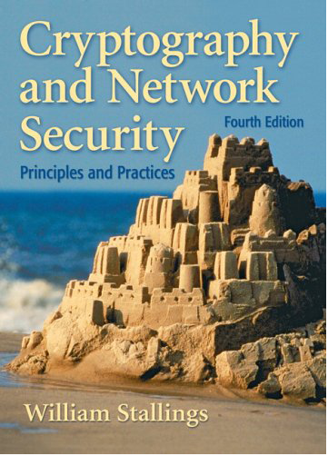
Cyber Security Section 1
Chapter 1: Introduction
Chapter 2: Classical Encryption Techniques

Slide 2
Introduction
Cryptology:
This is the study of techniques for ensuring the secrecy and/or authenticity of information. The two main branches of cryptology are:
Cryptography: which is the study of the design of such techniques;
Cryptanalysis: which deals with the defeating such techniques, to recover information

Slide 3
Introduction
Computer security: Refers to the security of computers against intruders (e.g., hackers) and malicious software (e.g., viruses).
Typically, the computer to be secured is attached to a network and the bulk of the threats arise from the network.
Network security: This area covers the use of cryptographic algorithms in network protocols and network applications.

Slide 4
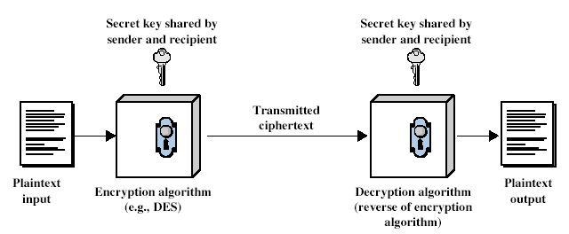
Classical Encryption Techniques
Simplified Model of Conventional Encryption

Slide 5
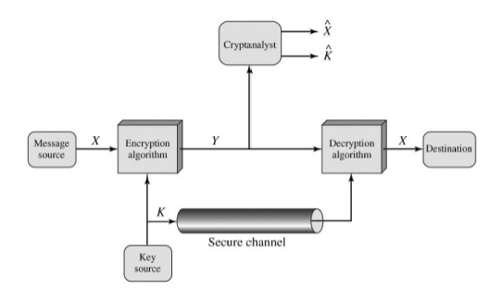
Classical Encryption Techniques
Model of Conventional Cryptosystem

Slide 6
Classical Encryption Techniques
Unconditionally Secure:
C.T have no enough information to determine only one corresponding P.T
Computationally Secure:
Cost to break the cipher exceeds the value of the information
Time required to break the cipher exceeds the information life time

Slide 7
Classical Encryption Techniques
Encryption techniques can be classified according to:
Type of Operation used
Number of keys used
The way the data processed
Substitution
Transposition
Product
Symmetric ( 1 key)
Asymmetric ( 2 keys)
Public - Private
Using one way math function
f(x)🡪 y … easy
f⁻¹(y)🡪 … infeasible
No key distribution problem
Block Cipher
Stream Cipher

Slide 8
Classical Encryption Techniques
Cryptanalysis techniques can be classified according to:
Methodology
Amount of available information
Cryptanalysis Attack
Depends on the nature of the algorithm and lang. characteristics
(Differential, Linear)
Brute Force Attack
Try every possible key on C.T till get an intelligible transformation of C.T
Cipher text only
(Enc + C.T)
Known P.T
(Enc+ C.T🡪P.T pairs)
Chosen P.T
(Enc+ C.T🡪 P.T specific pairs)

Slide 9
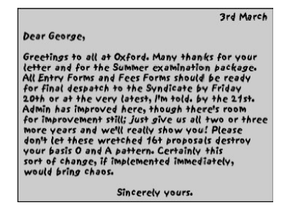
Steganography
Methods of hiding the existence of a message or other data. This is different than cryptography, which hides the meaning of a message but does not hide the message itself.

Slide 10
Substitution Techniques
Ceaser
Monoalphabetic
Polyalphabetic
Playfair
Hill Cipher

Slide 11
Substitution Techniques
Ceaser
Monoalphabetic
Polyalphabetic
Playfair
Hill Cipher

Slide 12

Ceaser Cipher
A | 0
B | 1
C | 2
D | 3
E | 4
F | 5
G | 6
H | 7
I | 8
J | 9
K | 10
L | 11
M | 12
N | 13
O | 14
P | 15
Q | 16
R | 17
S | 18
T | 19
U | 20
V | 21
W | 22
X | 23
Y | 24
Z | 25
Assign numeric equivalent for each letter
For each P.T letter P substitute with C.T letter C
where index of C = (index of P + key) mod 26
Example: P.T = Computer, Key = 8
P.T | c | o | m | p | u | t | e | r
P.T Index | 2 | 14 | 12 | 15 | 20 | 19 | 4 | 17
C.T Index | 10 | 22 | 20 | 23 | 2 | 1 | 12 | 25
C.T | K | W | U | X | C | B | M | Z
Decryption?
# of keys ?
Cryptanalysis?

Slide 13
Monoalphabetic Cipher
a | D
b | Q
c | E
d | P
e | R
f | S
g | F
h | T
i | A
j | W
k | X
l | U
m | G
n | O
o | B
p | V
q | H
r | N
s | C
t | M
u | I
v | Z
w | L
x | Y
y | J
z | K
Use any permutation of alphabetic to substitute each letter in the P.T with its corresponding (Mapping)
Example: P.T = Computer, Key = this permutation
P.T | c | o | m | p | u | t | e | r
C.T | E | B | G | V | I | M | R | N
Decryption?
# of keys ?
Cryptanalysis?

Slide 14
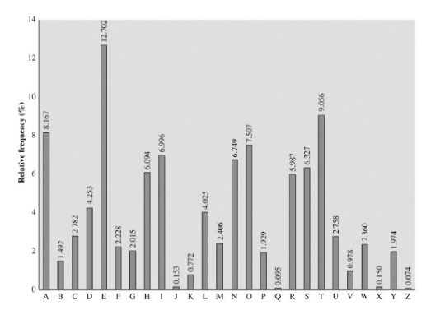
Monoalphabetic Cipher

Slide 15
Monoalphabetic Cipher
To increase the immunity of monoalphabetic cipher
Using homophones
Polyalphabetic
Higher order substitution
Block cipher
a | D,-,?
b | Q,2,T
c | E,7,&
. . . | . . .
a | D | O
b | Q | L
c | E | V
. . . | . . . | . . .
aa | DS
ab | CG
ac | HH
. . . | . . .

Slide 16
Playfair Cipher
It is a multiple letter substitution cipher.
It treats diagrams (block of two letters) in plaintext as single units and translates these units into ciphertext diagrams.
The playfair algorithm is based on the use of 5x5 matrix of letters constructed using a keyword

Slide 17

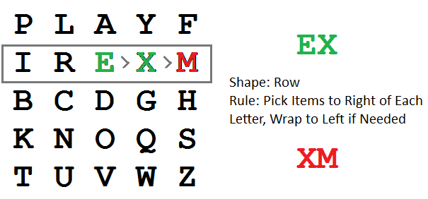
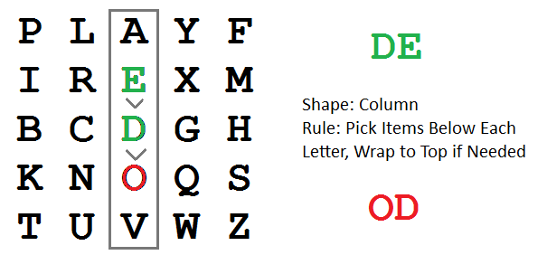
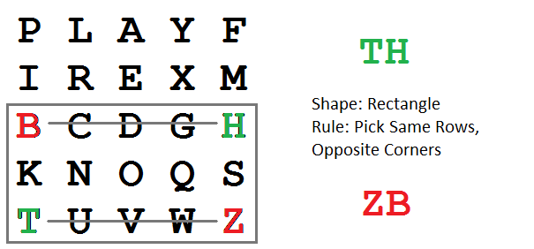
Playfair Cipher
The matrix is constructed using the keyword, Example, keyword = “playfairexample”
Plaintext is encrypted as two letters as a time, according to the following rules:

Slide 18
Playfair Cipher
Example: P.T = communication, Keyword = “playfairexample”
Decryption?
# of keys ?
Cryptanalysis?
P.T | co | mx | mu | ni | ca | ti | on
C.T | DN | IM/ JM | RZ | KR | DL | PB | QO

Slide 19
Your Turn … ☺
Encrypt the following P.T = “ Computer Systems” using playfair cipher with keyword = “balloon”

Slide 20
Security Package
The package will include the implementation of the algorithms we explain in the section. And at the end of each lab the required tasks will be announced with their deadline.
Each group will upload the code to the GoogleDrive shared with the Gmail you wrote in the form(Don’t rename your shared folder).
Groups 3 – 6 members.
Registration Form (will be updated), Deadline Sat 23/2/2024.
After the Registration deadline a mail will be sent for each team with a link to its shared folder with the TAs.
Deadlines are not extendable.
Avoid cheating or copying algorithms. Your codes will be compared with each other. Any detected cheating or copying case will be punished.
Refer to the template and document for more details (link).
Notes:
Please go through the checklist and template with them

Slide 21
Security Package
Don’t rename files.
Don’t use external APIs.
Don’t import external libraries like (math).
Don’t change test cases or function names.
Notes:
Please go through the checklist and template with them

Slide 22
Package Milestone 1
Deadline to upload to GoogleDrive: 1st March 2024
You should implement the following
Ceaser
public string Encrypt(string plainText, int key)
public string Decrypt(string cipherText, int key)
public int Analyse(string plainText, string cipherText)
Monoalphabtic
public string Encrypt(string plainText, int key)
public string Decrypt(string cipherText, int key)
public int Analyse(string plainText, string cipherText)
public string AnalyseUsingCharFrequency(string cipher)
Playfair
public string Encrypt(string plainText, string key)
public string Decrypt(string cipherText, string key)

Slide 23
Important Links:
Sections Materials:
https://drive.google.com/drive/folders/16DJRdmifdYYxygIH2EyXCkQiQdRDSnSj?usp=sharing
Package Registration Form:
https://docs.google.com/forms/d/e/1FAIpQLSfxNH1efcCop5lEntnh6Ir0q_BAg7bmqc_yIZAXI2hP8QlRVg/viewform?usp=sf_link
Notes:
Not updated

Slide 24

1

